Slide 1


Pizza Party App
Jon Ledbetter, Helen Nguyen, Barbara Saboe, Andy Le, Felipe Orrego, & Diana Velazquez

Slide 2
Table of Contents
User Guide: Getting Started using Pizza Party App………………………………………………..……………………...3
Data Flow Diagrams………………………………………………………...…………………………………………….10
Model Relationship Diagram……………………………………………………………………………………………..18
Current & Future Features………………………………………………………………………………………………..20
User Stories……………………………………………………………………………………………………………….23
Feature Tests……………………………………………………………………………………………………………...25
Ethical Considerations…………………………………………………………………………………………………....39
Project Backlog…………………………………………………………………………………………………………...41

Slide 3
User
Guide

Slide 4
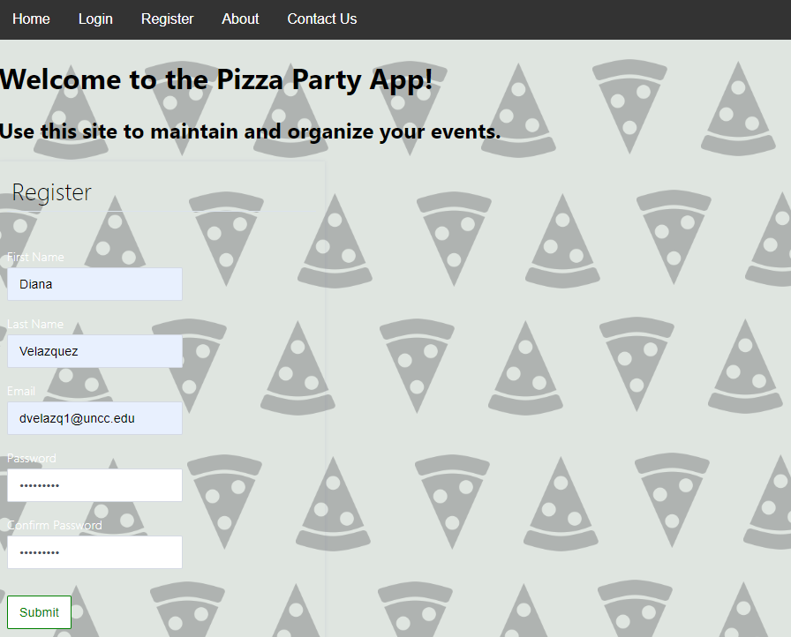
Step 1: Sign Up for an Account
Click Here to Register!
To get the most out of Pizza Party App sign up for an account with us!
Click on the “Register” option from the navigation bar
Enter in your first and last name
Enter your email address
Create a password (don’t worry if its not strong enough we will let you know!)
Confirm your password
Hit the submit button
Click Here Submit Registration Form!

Slide 5
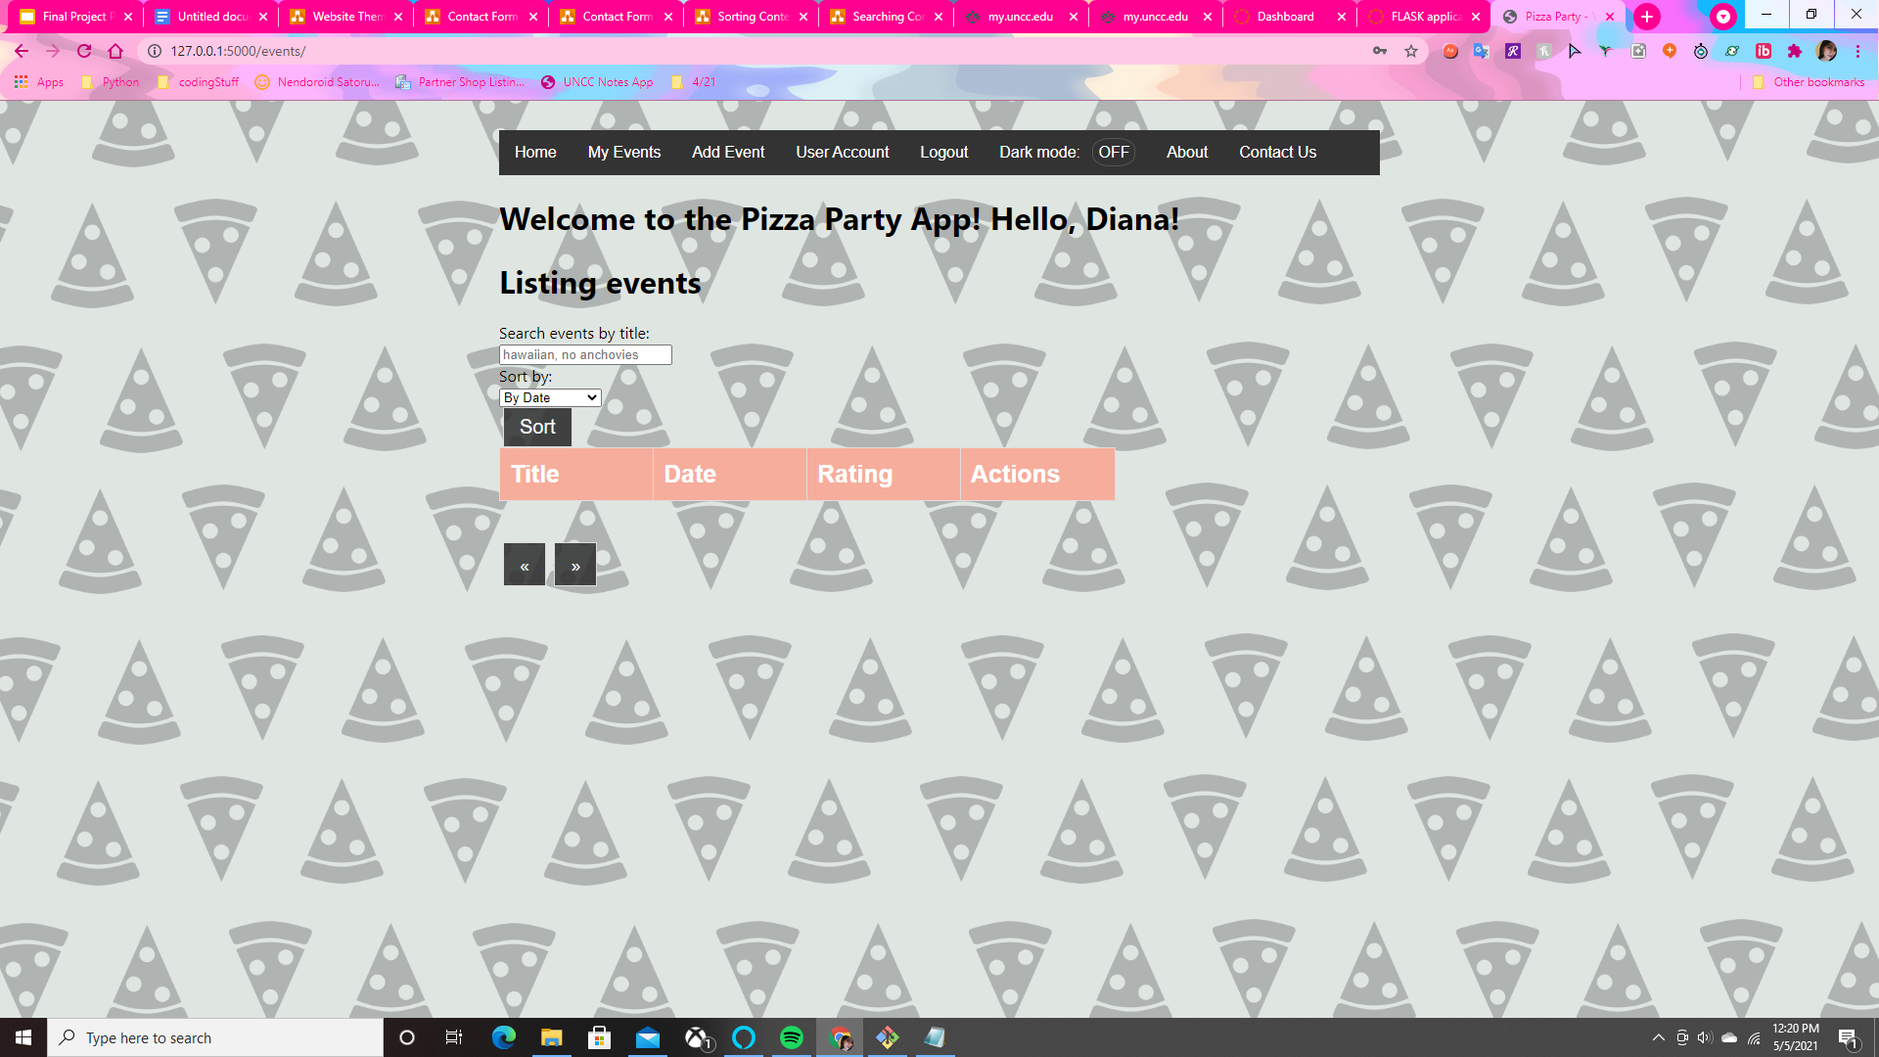
Step 2: Create your First Event (part 1)
Click Here to Add a New Event!
After you make your account you should see a page that look like this -->
This is your event list! As you can see, because you are a new user it will be empty at first but don’t worry we will guide you through how to make events!
First go ahead and click on the “Add Event” option from the navigation bar

Slide 6
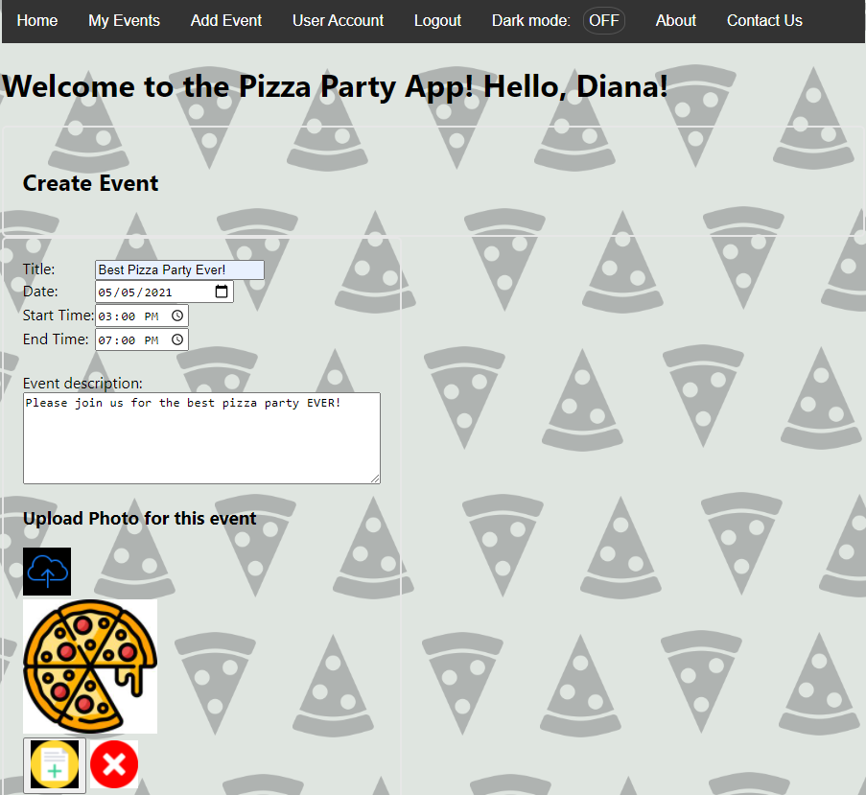
Step 2: Create your First Event (part 2)
2. Fill out the title of your event
3. Select the date the event will take place
4. Create a starting and ending time for the event
5. Type in a brief description for the event

Slide 7
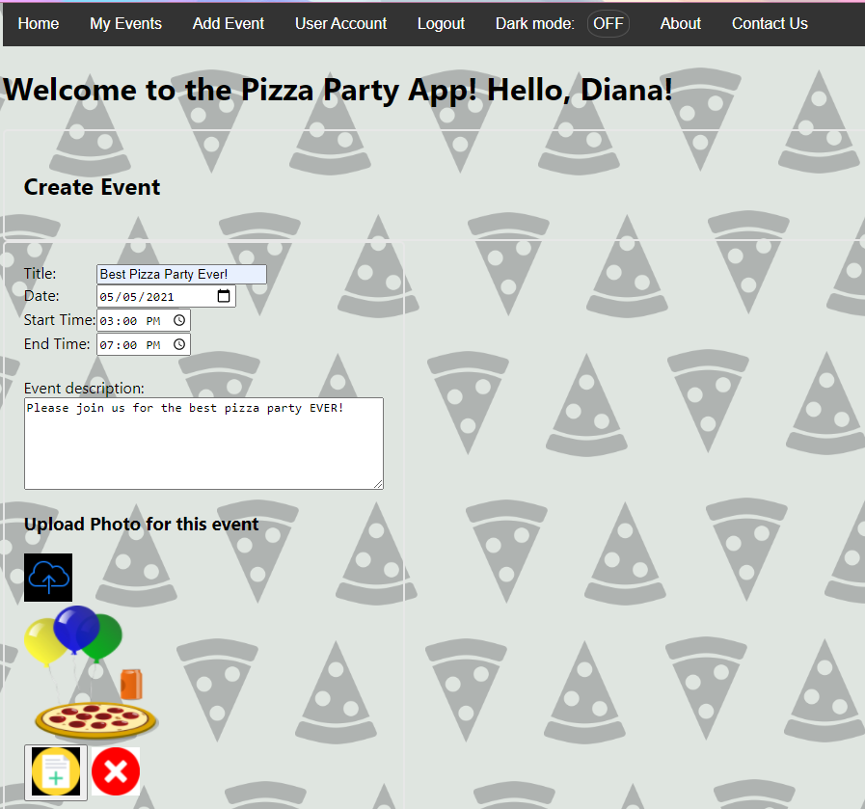
Step 2: Create your First Event (part 3)
6. If you want you can add images to your event too!
7. To finish making your event hit the “+” button at the bottom
8. If you want to cancel making the event you can hit the “X” button instead
Click Here to Add a Photo for the Event!
Click here to submit and create your event!
Click here to cancel making the event

Slide 8
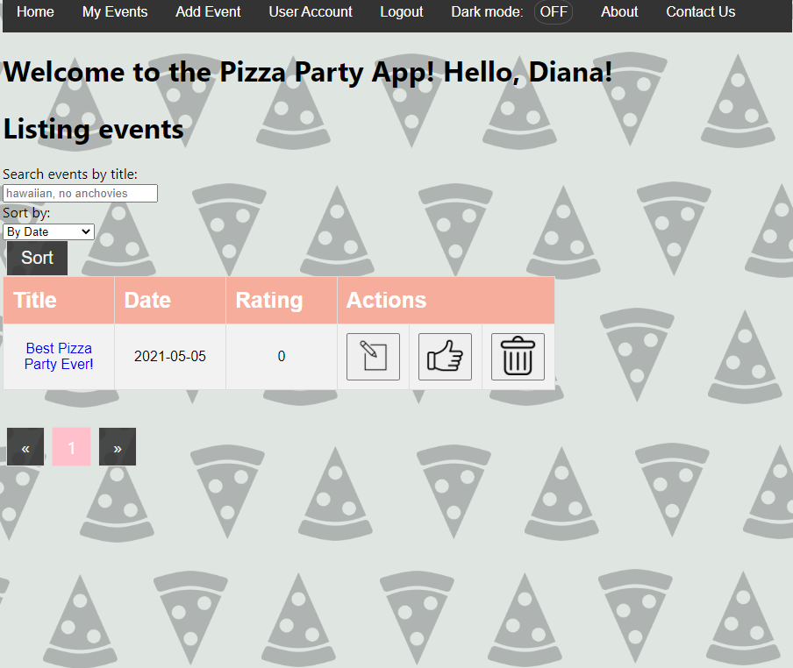
Step 3: View Your Event List
View Your
Event List
Click Event Title to View its Page!
After you make your first event you should be navigated back to the Event List Page. Here you can see your newly created event. You can also always access this page by selecting “My Events” from the navigation menu
Here are some other things you can do from this page:
You can view events by clicking on their title
You can search and sort events
You can also update, rate and delete events
Enter a search term here to find events
Click here to sort events by date/starting or ending time/ alphabetically
Click to delete
Event
Click to edit Event
Click to like Event

Slide 9
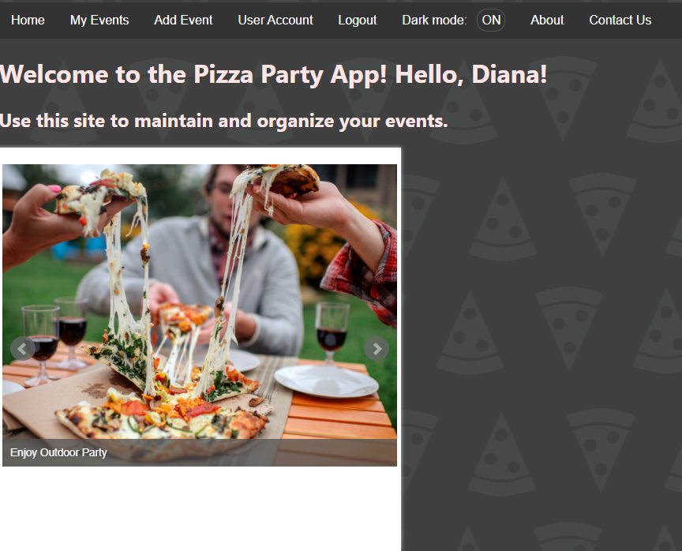
Step 4: Logout
Create
New
Event
Change
User
Settings
Visit our Homepage
View Your
Event List
Click Here to Logout
Change
Theme
View
About Page
Contact Team Wetblock
Now that you have the basic down, you can go ahead and logout or continue playing around with the website if you want!
To logout hit the “Logout” option on the navigation bar
You can also click on “Contact Us” if you have any feedback, questions or concerns
Clicking on “User Account” allows you to change your settings
Clicking on the “Dark Mode” option will turn on/off the dark theme
If you want to learn more about us feel free to check out our “About” page!

Slide 10
Data Flow Diagrams

Slide 11
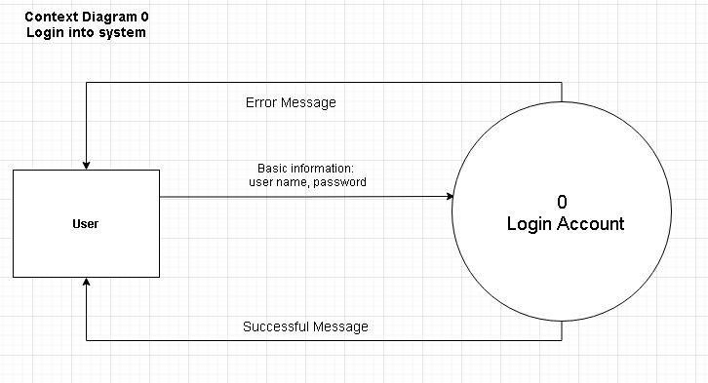
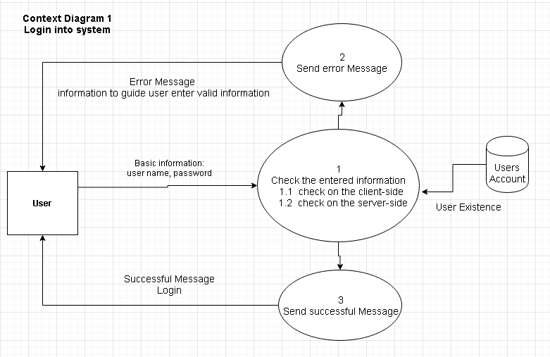
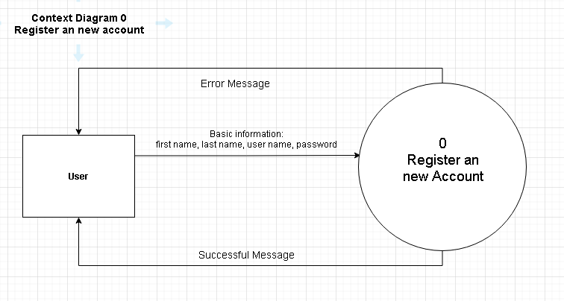
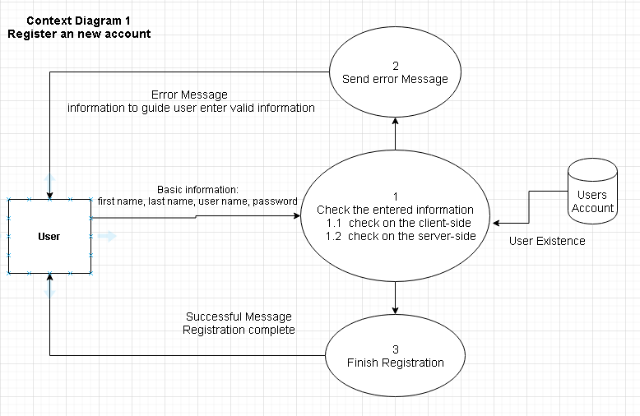
Login & Registration

Slide 12
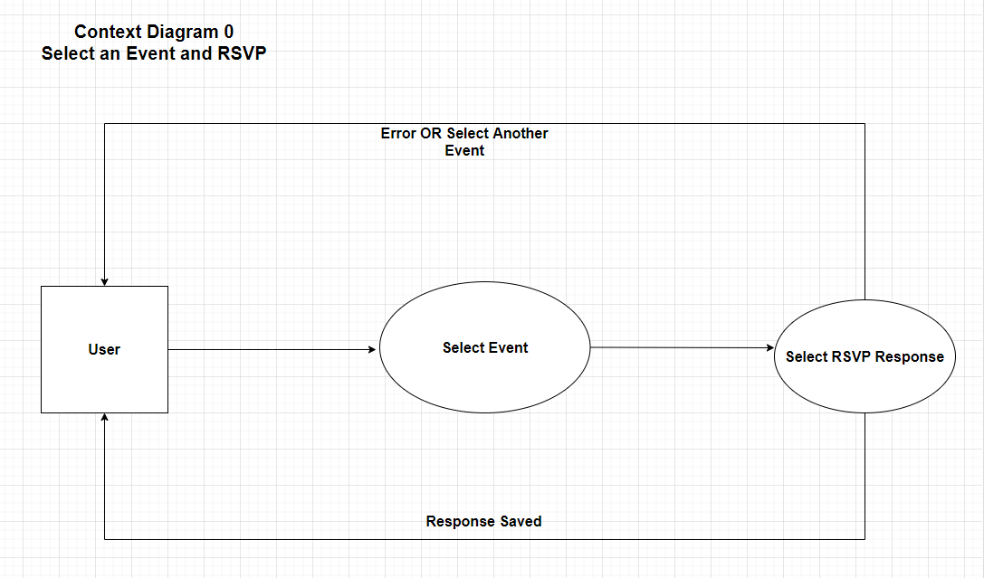
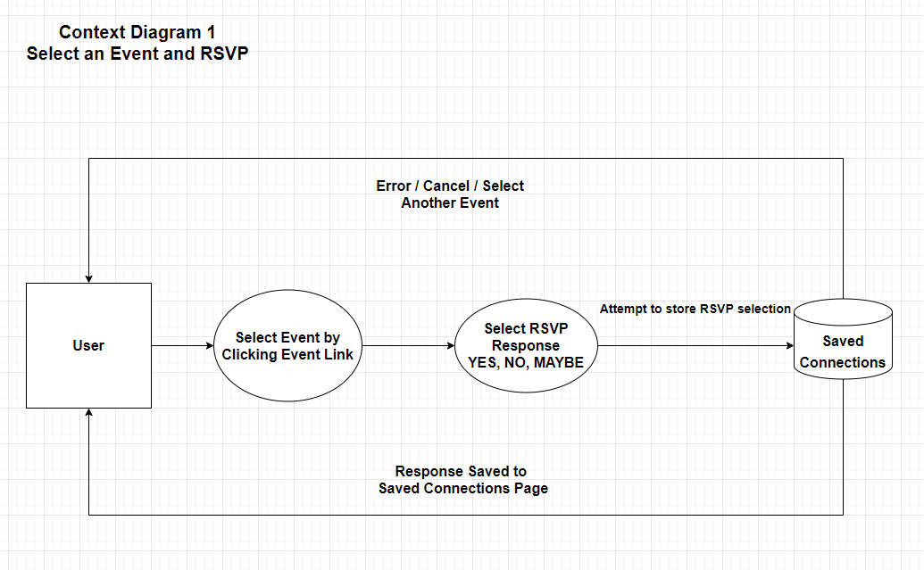
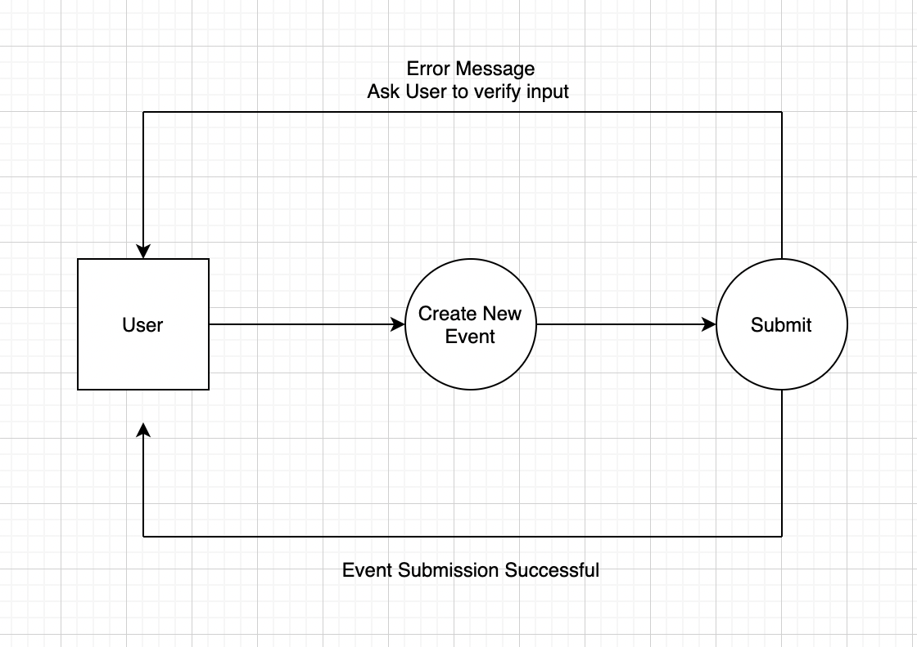
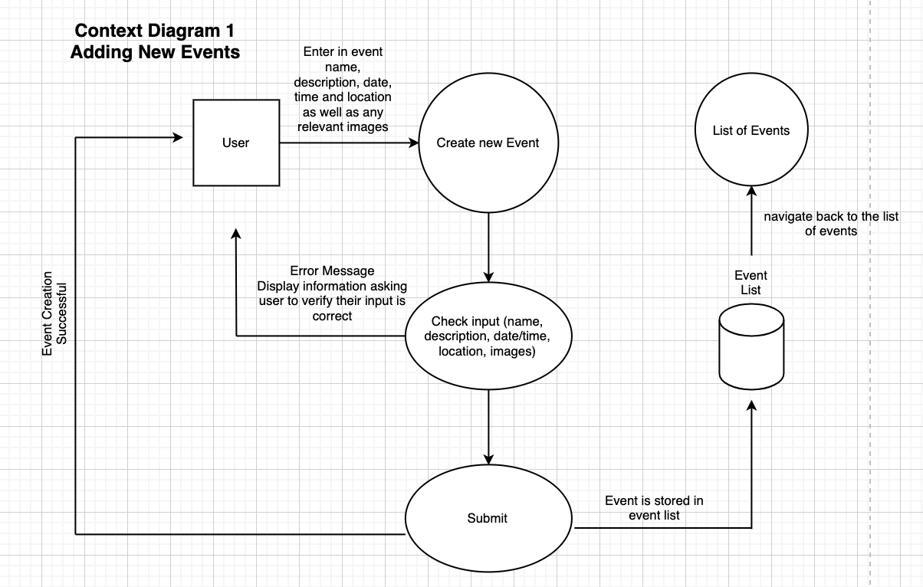
Event Selection & Creation

Slide 13
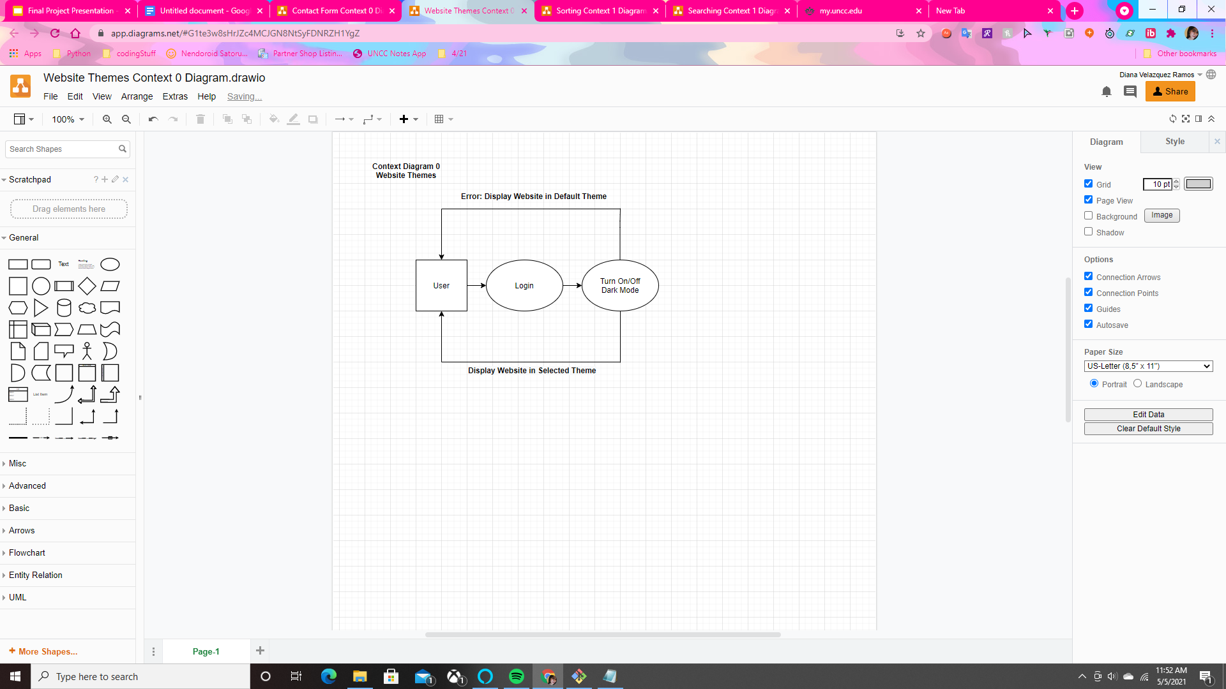
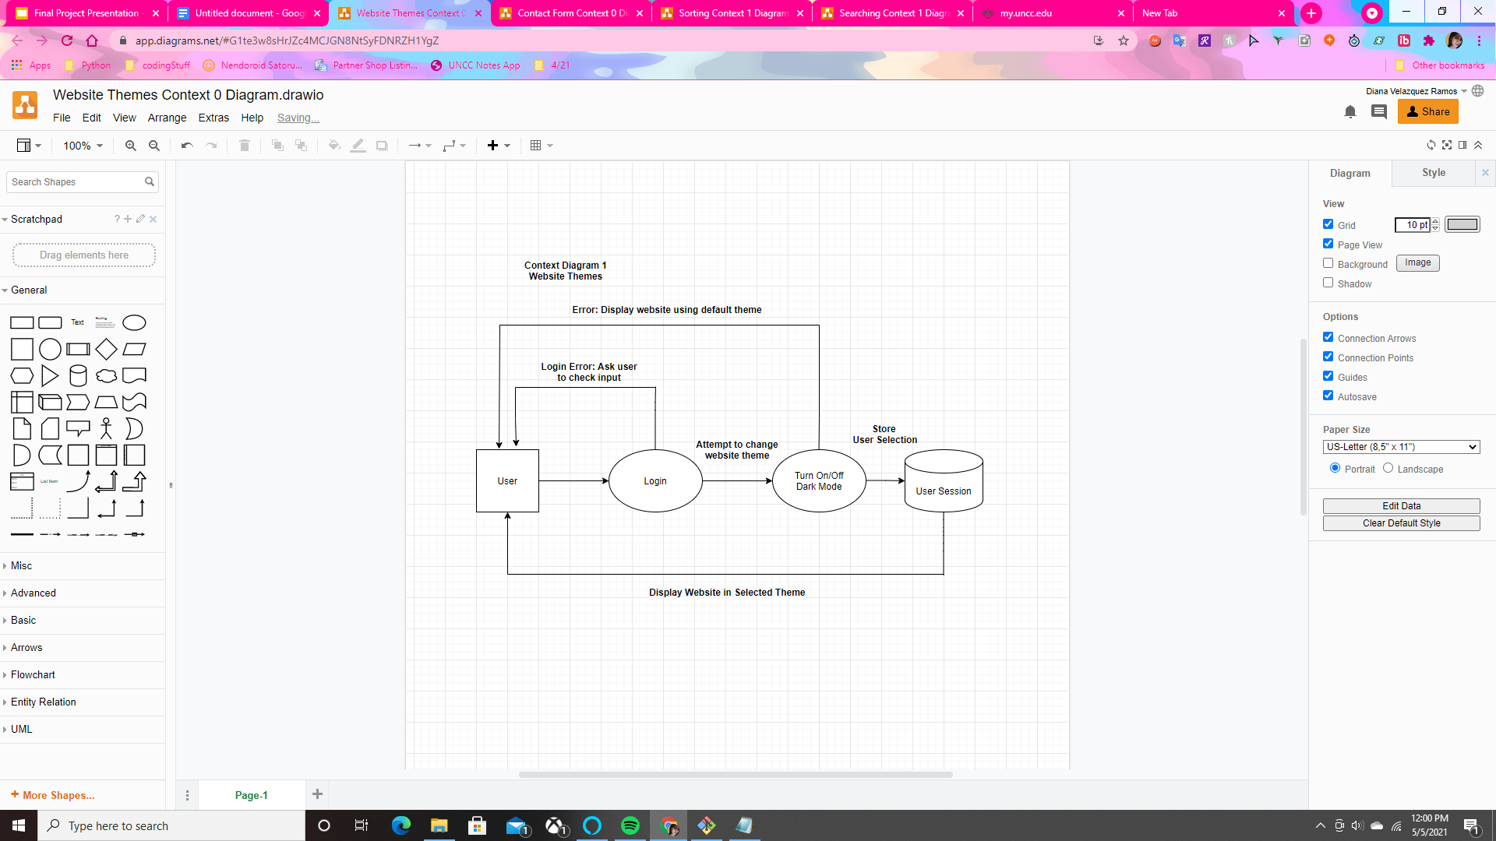
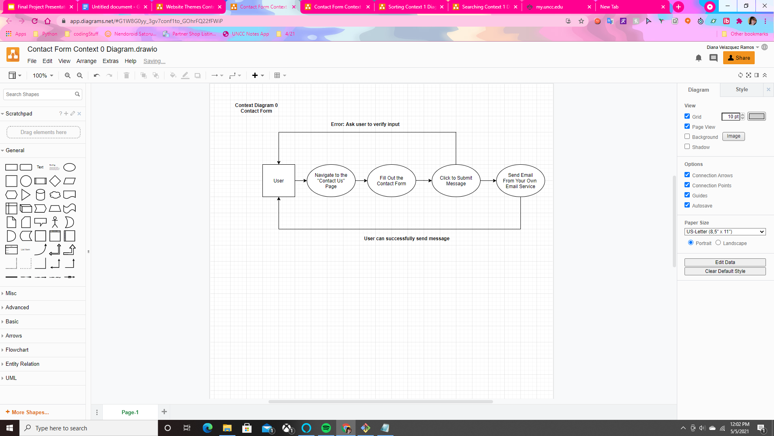
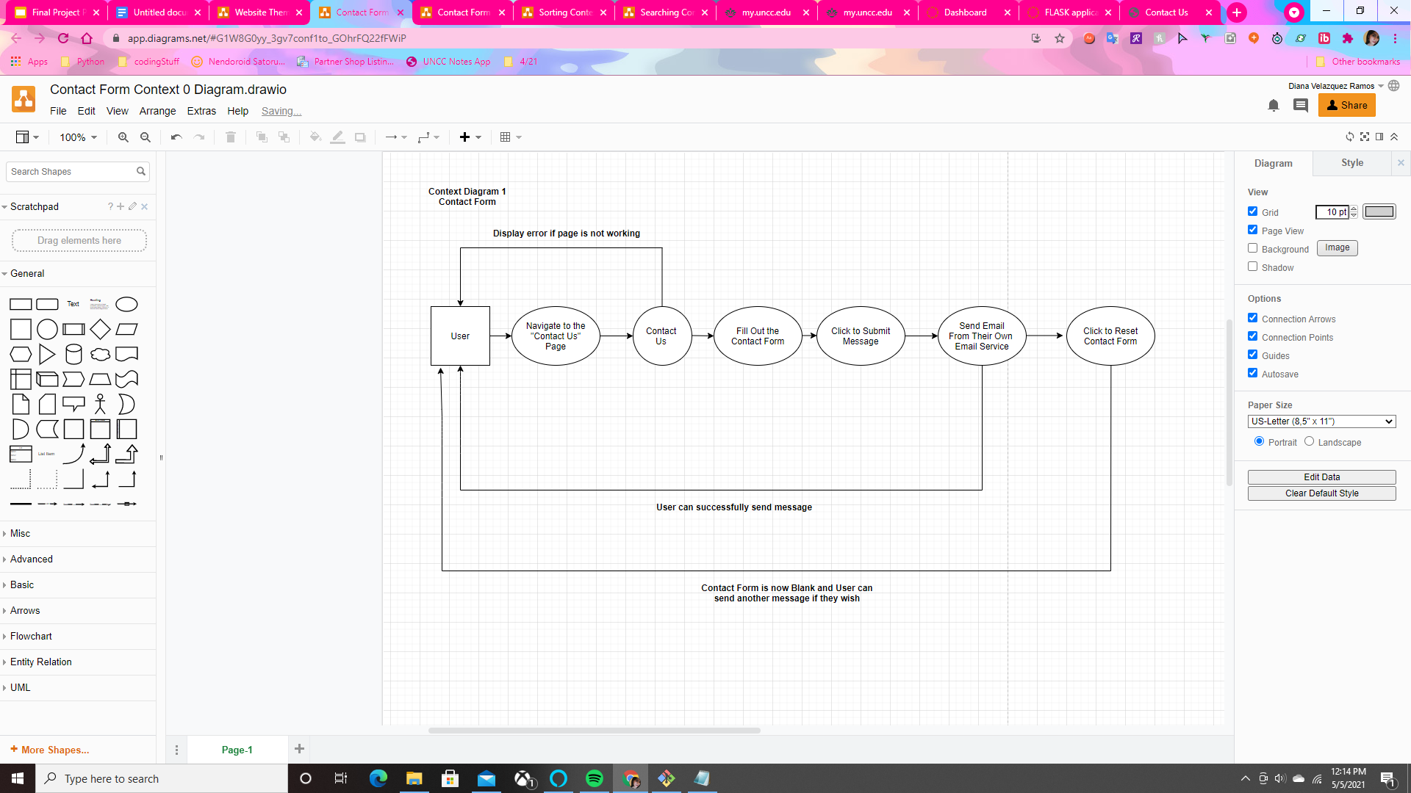
Website Themes & Contact Form

Slide 14
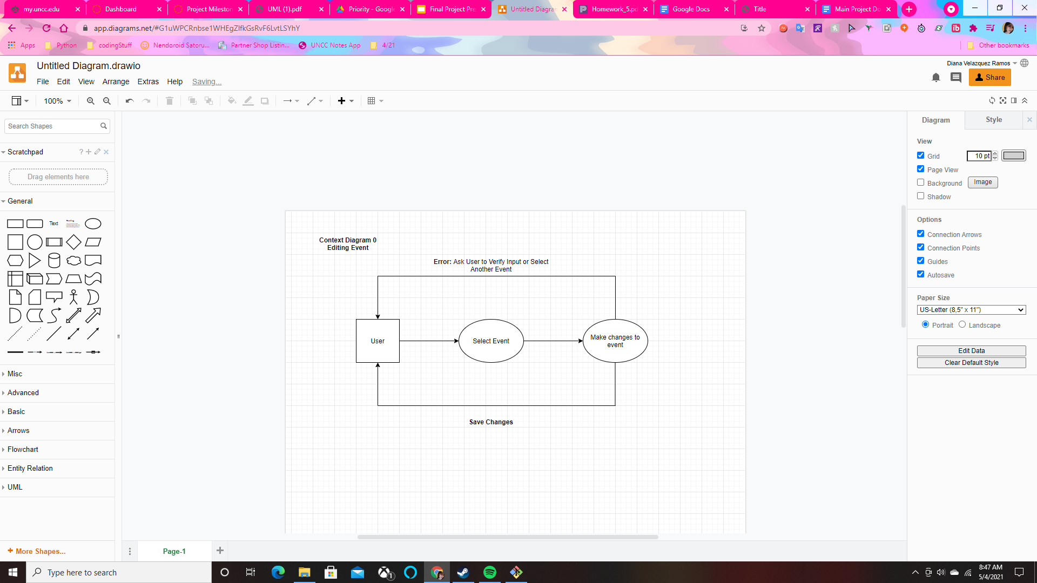
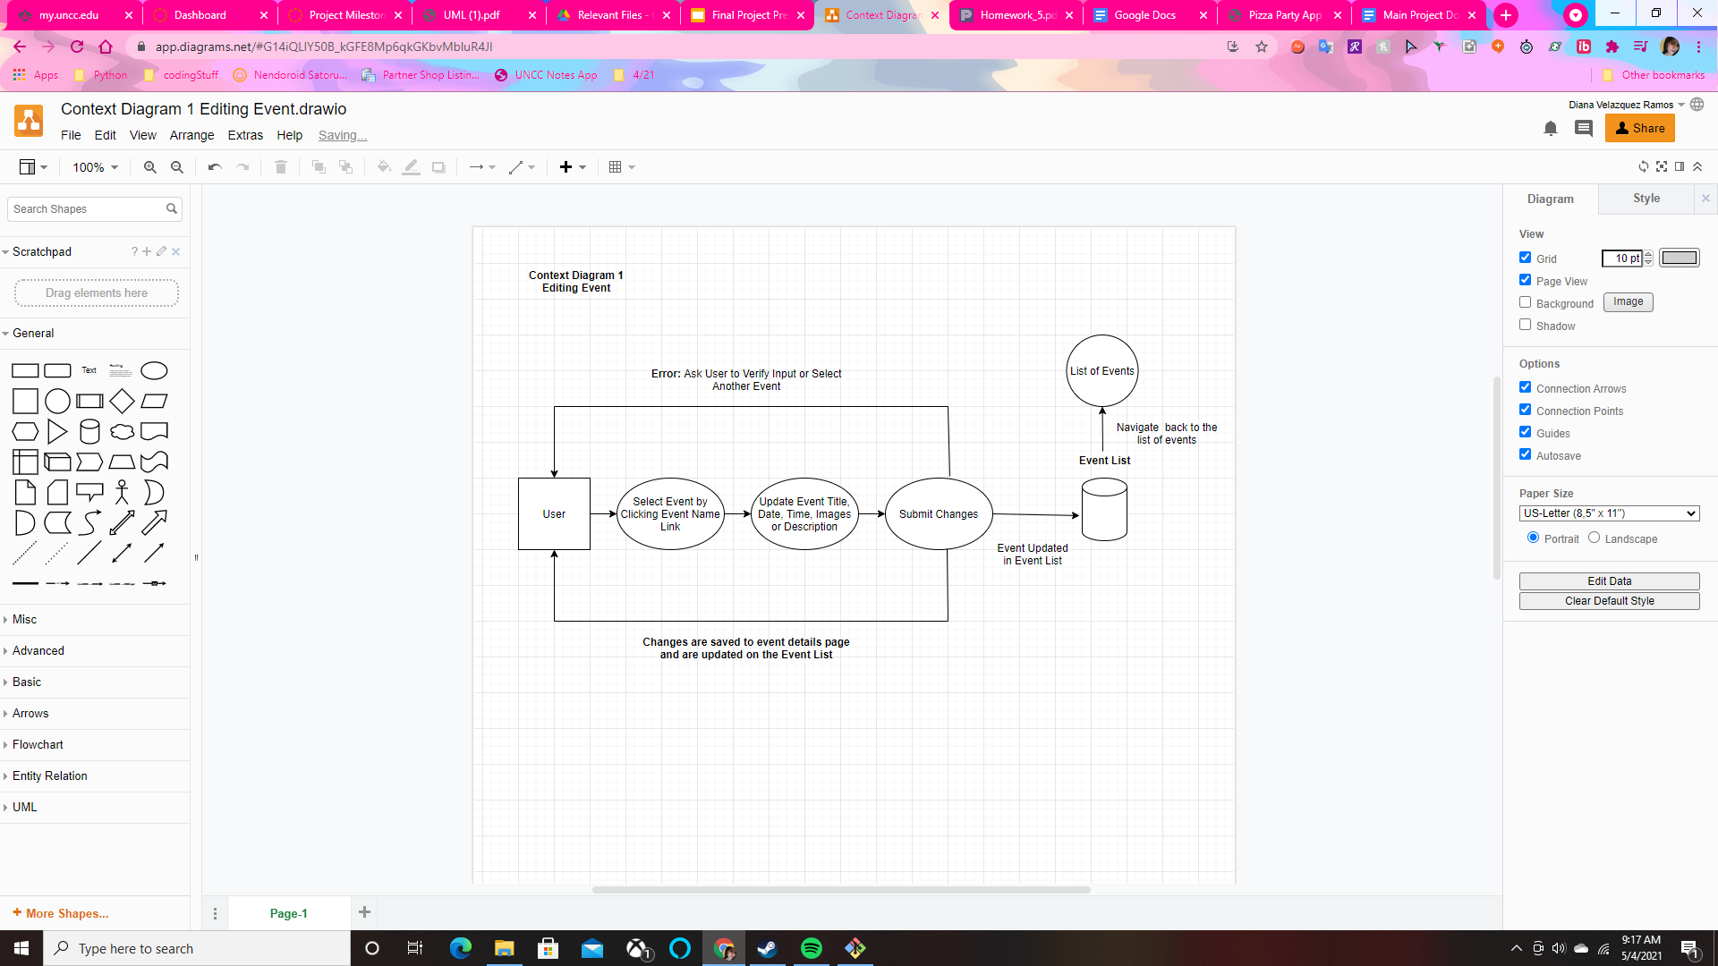

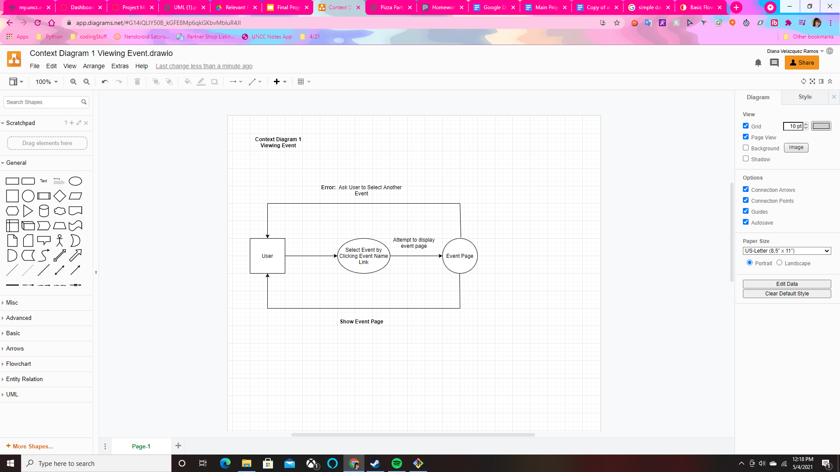
Editing & Viewing an Event

Slide 15
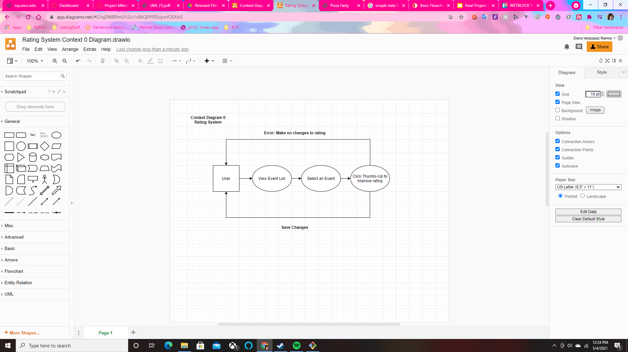
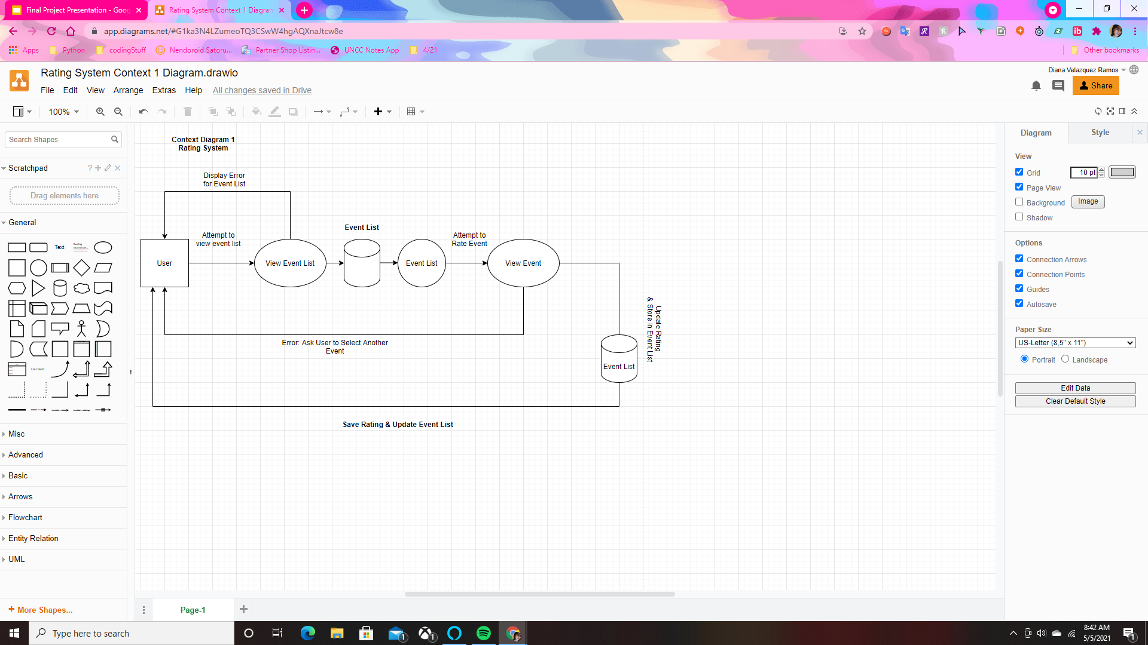

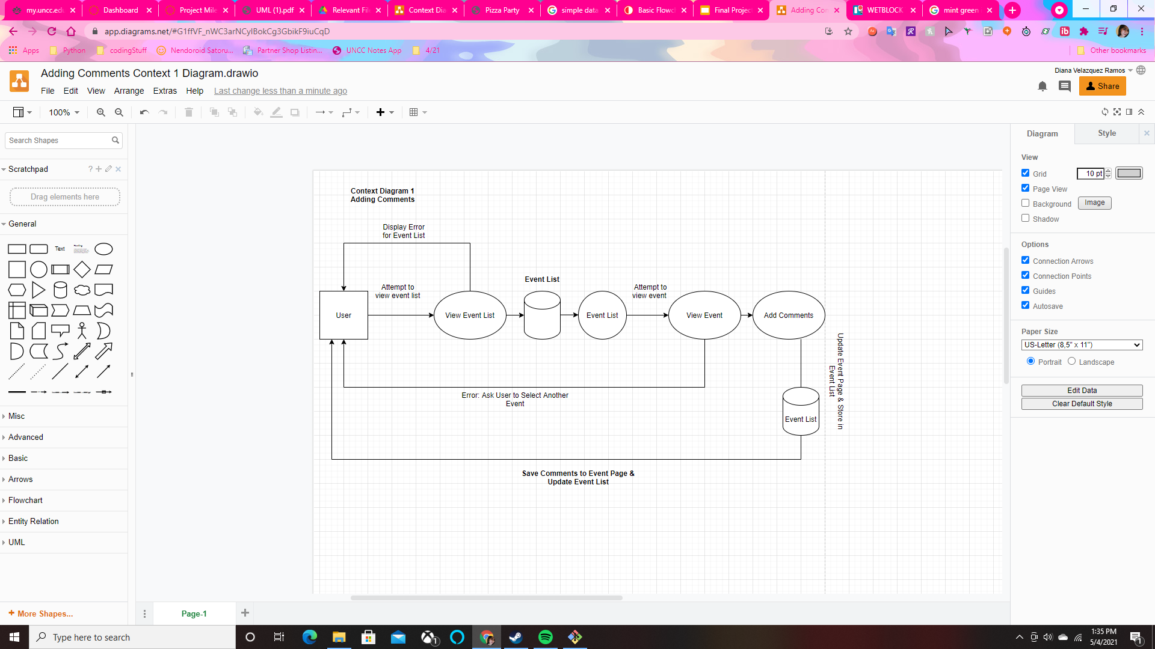
Rating System & Adding Comments

Slide 16
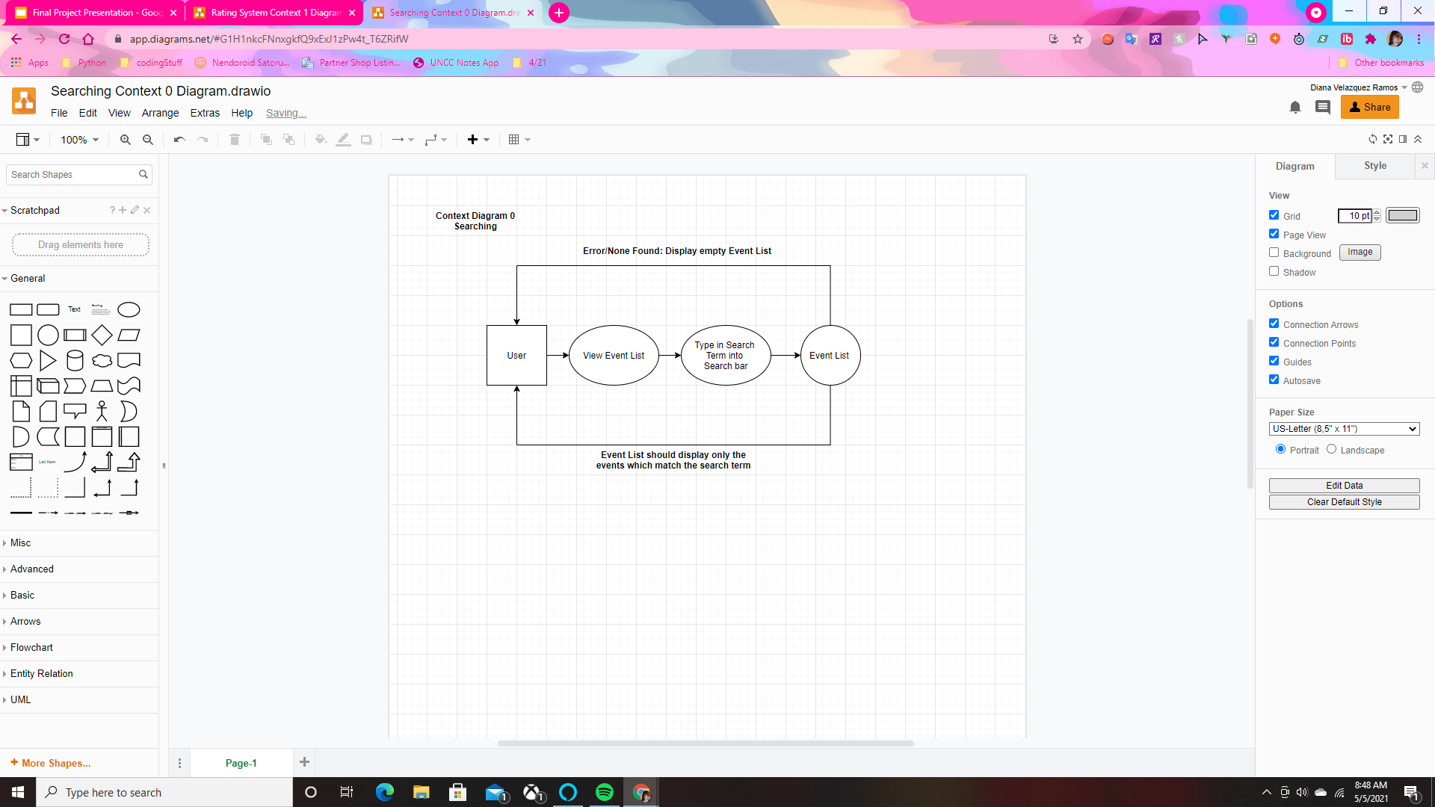
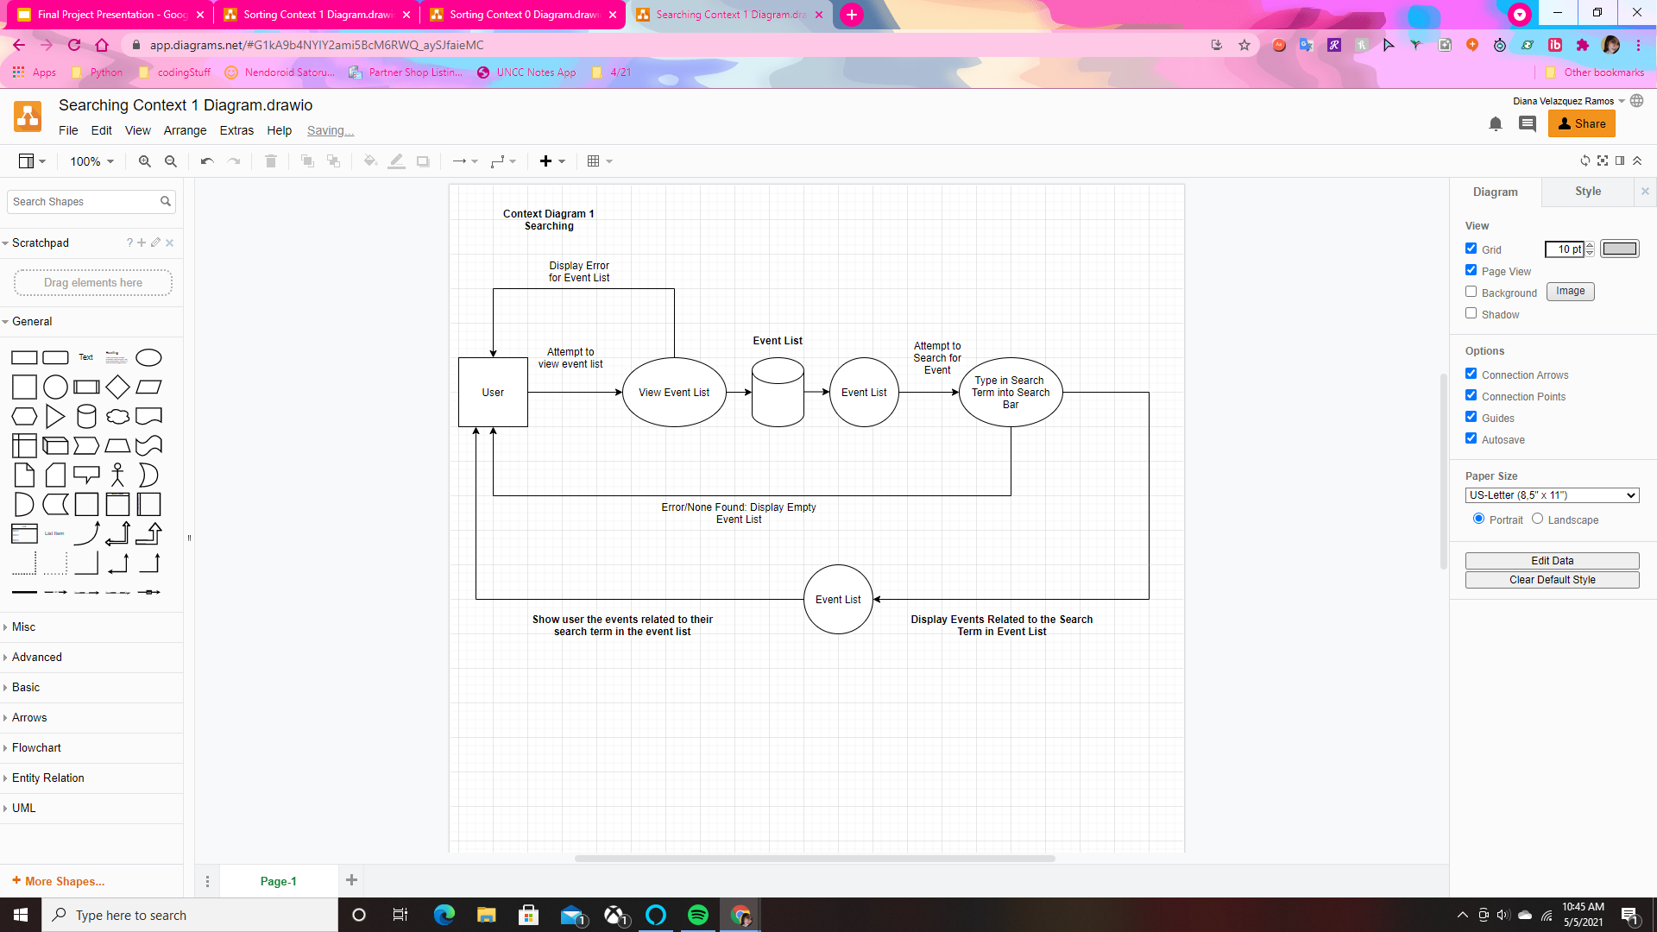
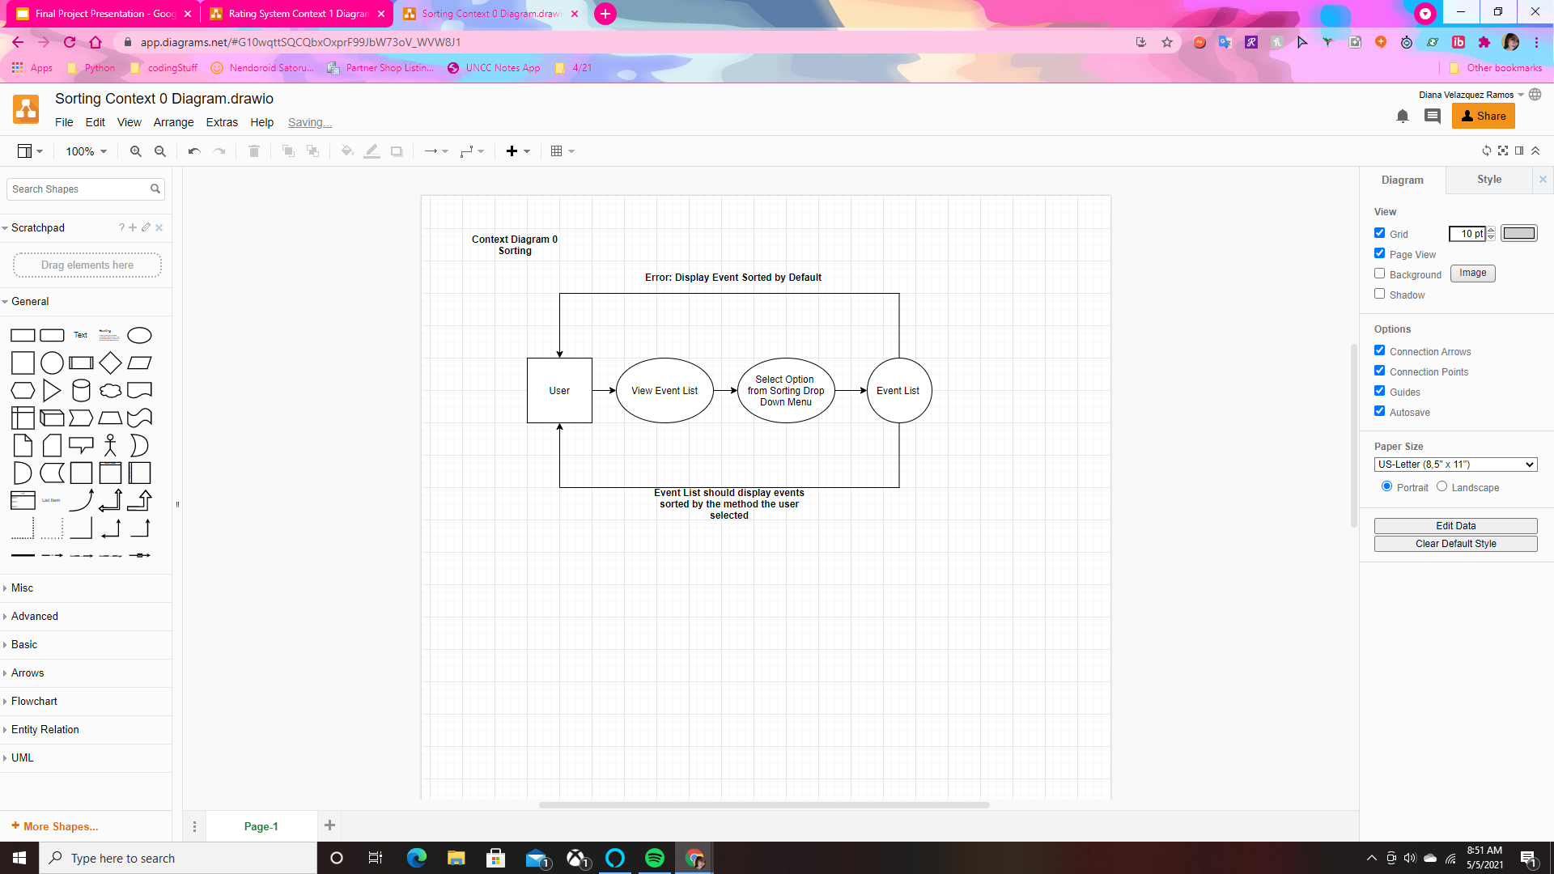
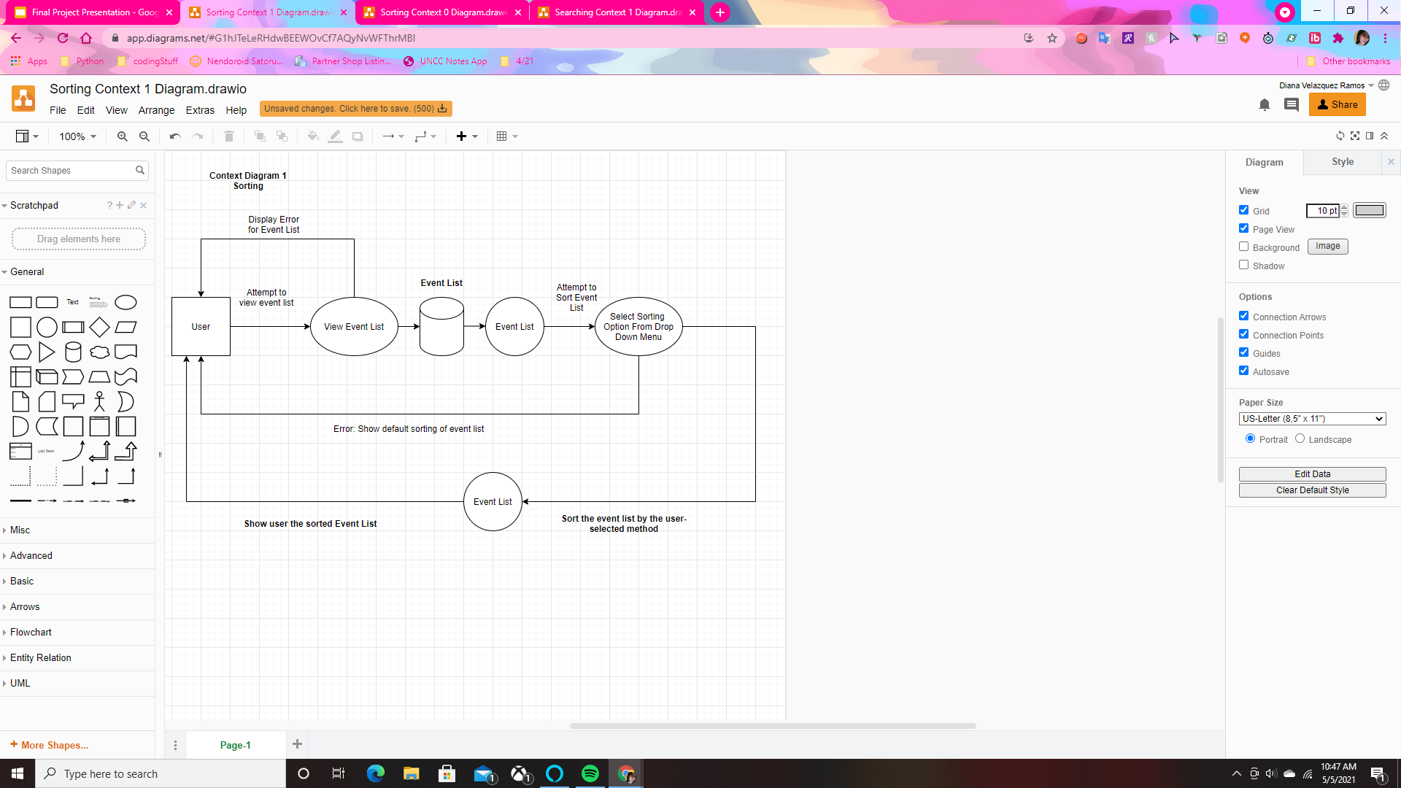
Searching & Sorting Events

Slide 17
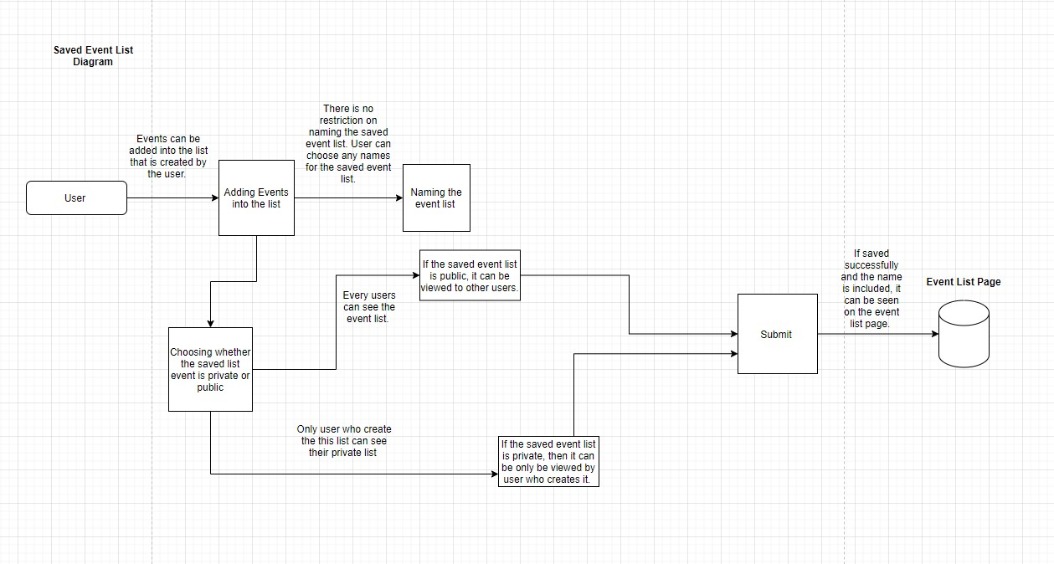
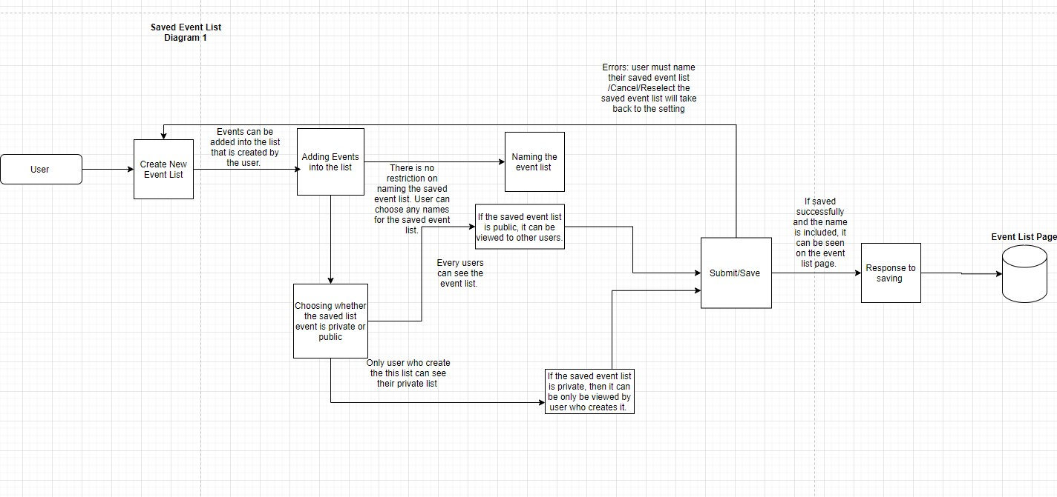
Event List

Slide 18
Model Relationship Diagram

Slide 19
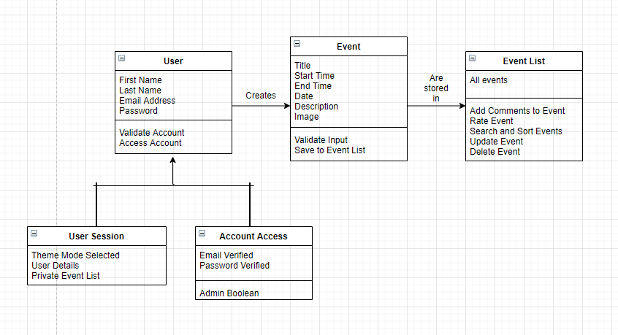
Model Relationship Diagram

Slide 20
Current & Future Features

Slide 21
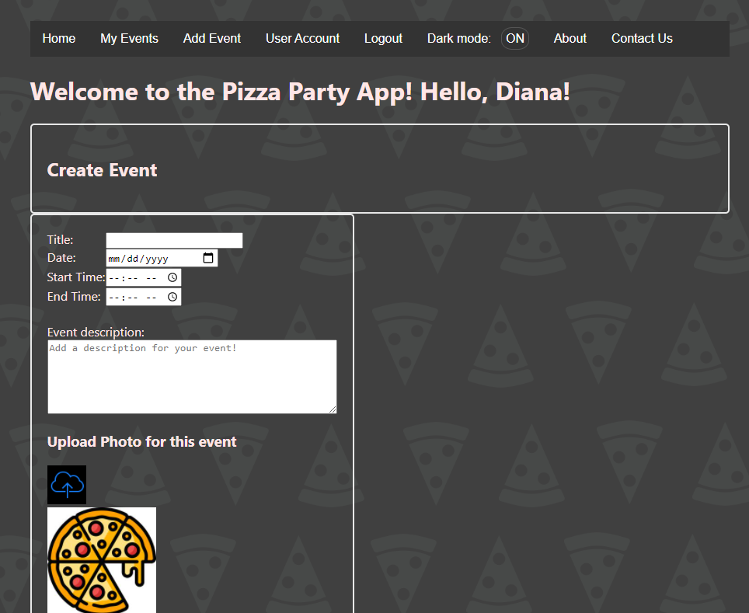
Current Project Features
The current features in the project include:
Login & Registration: Allows user to have access to their own accounts
Adding New Events: Allows users to create events
Viewing Events: Allows users to view events
Editing Events: Allows users to update events
Deleting Events: Allows users to delete events
Rating System: Allows users to rate events and view ratings
Adding Comments to Events: Allows users to express their thoughts about events
Light & Dark Mode themes: Allows users to change the website theme
Searching & Sorting: Allows users to find events faster
Adding Images to Events: Allows users to add images to events
Contact Form: Allows users to contact Team Wetblock

Slide 22
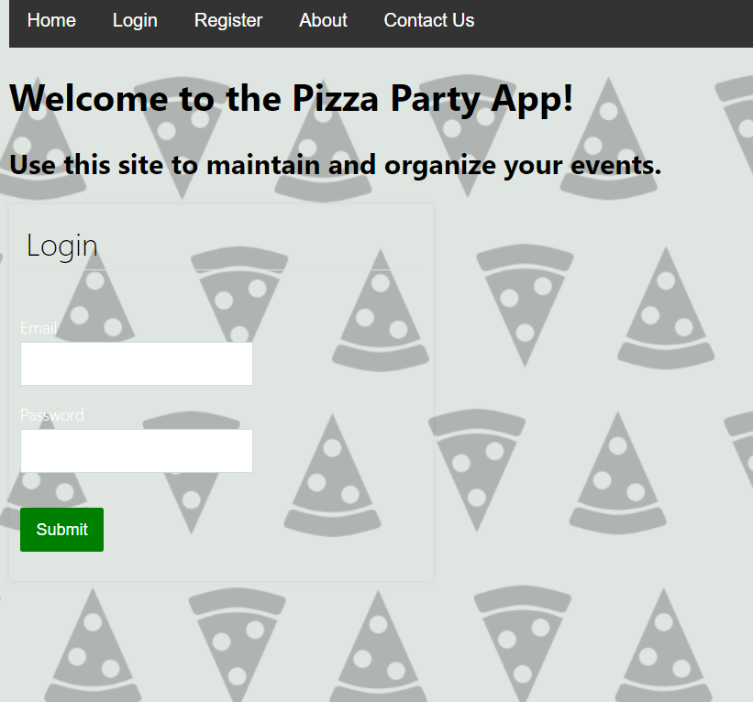
Future Project Features
Other features we seek to implement include:
Forgot Password
Inviting Friends
Sharing Events with Others
Embed Links to Social Media Platforms
Confirmation to Logout (Are you sure you want to Logout?)
Forgot password?

Slide 23
User
Stories

Slide 24
List of User Stories
#1: LOGIN: As a user, I want to be able to have a unique user ID and password so that only I can access my information stored on this site.
#2: REGISTRATION: As a user, I want to be able to create an account to keep my data safe and private from other users.
#3: VIEW EVENT: As a user, I want to be able to see the events that I have created previously.
#4: UPDATE EVENT: As a user, I would like to update my events when information changes.
#5: DELETE EVENT: As a user, I would like to delete certain events from the website.
#6: CREATE EVENT: As a user, I want to create a new event entries which include basic information, such as the title of the event, description, and detailed content, images, etc.
#7: SEARCHING: As a user, I want to be able to search for events in my event list to easily access events.
#8: SORTING: As a user, I want to be able to sort my event list to easily access events.
#9: EVENT LIST: As a user, I need to list all of the events that I have already created. The list should be displayed in the table format.
#10: RATING SYSTEM: As a user, I want to be able to rate events based on how interesting they seem as well as view current ratings for other events.
#11: CONTACT FORM: As a user, I want to be able to contact the creators of the website if I want to provide feedback or have questions/concerns.
#12: WEBSITE THEMES: As a user, I would like to be able to toggle between light and dark mode on the website.
#13: ADDING COMMENTS: As a user, I want to be able to add comments and view comments for events.

Slide 25
Feature Tests

Slide 26
Login
Feature: Login
User Story: As a user, I want to be able to have a unique user ID and password so that only I can access my information stored on this site.
Scenario: As a user, I want to input my user ID and password to be able to see my saved connections list.
GIVEN: I am on the user login page.
WHEN: I enter my userID and password in the appropriate text boxes and click the “Login” button
THEN: I should see the browser navigate to my saved connections list for review.
GIVEN: I navigate to the list of available events while logged in.
WHEN: I click on an available event
THEN: I should navigate to the event details of the event I chose.
GIVEN: I decide to submit an RSVP Response to the event selected
WHEN: I click “YES”, “NO”, or “MAYBE”
THEN: My response and the event itself should be saved in my list of connections without requiring me to login again.

Slide 27
Registration
Feature: Registration
User Story: As a user, I want to be able to create an account to keep my data safe and private from other users.
Scenario: As a user, I want to create a new account.
GIVEN: I am on the home page and not logged into any account.
THEN: I should see a “register” button on the navigation bar.
WHEN: I click on the “register” button
THEN: I should see the registration page
WHEN: I fill out the required fields (First Name, Last Name, Email, Password & Confirmation) and hit the submit button
THEN: The website should display any errors such as missing fields, differences in passwords entered etc.
GIVEN: If there are no errors on the registration page
THEN: My responses are saved and my account will be created
THEN: I will be navigated to my very own event list!

Slide 28
View Event
Feature: View Event
User Story: As a user, I want to be able to see the events that I have created previously.
Scenario: As a user, I want to use the event list page to view previously created events.
GIVEN: I am on the event list page and logged into my account.
AND: I have created events previously that appear on my event list.
WHEN: I click on one of these previous events
THEN: I should be navigated to the page for that event
AND: I should see the event title, description, date/time, pictures as well as any user comments added for that event.

Slide 29
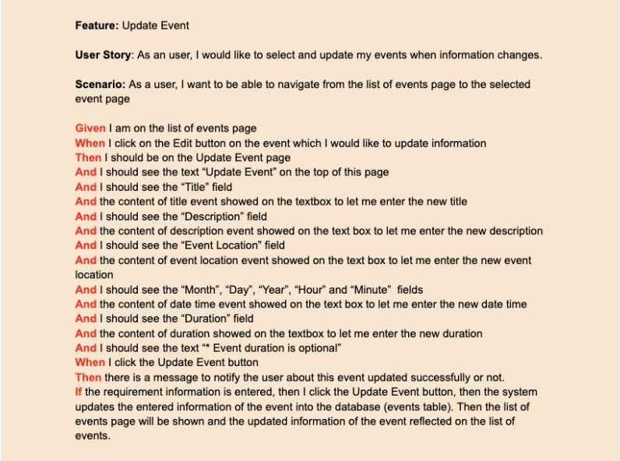
Update Event

Slide 30
Delete Event
Feature: Delete Event
User Story: As an event organizer, I would like to delete it from the website.
Scenario: As an event organizer, I want to be able to navigate from homepage to the event list page so that I can delete that one event.
Given I am on the homepage
When I click on the sign in/ registration links
Then I should have access to my account
When I click on the drop down navigation menu
Then I should see the Event List link option
When I click on the Event List option
Then I should see the Event List page
And I should see events listed.
And I should see the “create” button on the top right hand side event page.
And I should see the “update” button right hand side of the event
And I should see the “delete” button on the bottom right hand side of the event list page
And I should see the checkboxes on the left side of the event(s) which I can choose any event(s) to be moved to another event list or be deleted.
When I skim through the events, I choose a certain event that is cancelled.
Then I click the checkboxes right beside the event(s), I start to click the “delete” button.
And I should see the message pop up saying “You have successfully delete this event (or all events)”

Slide 31
Create Event
Feature: Create Event
User Story: As a user, I want to create a new event entries which include basic information, such as the title of the event, description, and detailed content, images, etc.
Scenario: As a user, I want to navigate from the website’s homepage to the new event page
Given I am on the homepage
When I click on the sign in/ registration links
Then I should have access to my account
And I should see the “Add Event” option on the navigation menu
When I click on the Add Event option
Then I should see the Adding Event page
And I should see the Event Title field
And I should see the Event Description field
And I should see the Event Location field
And I should see the Event Month field
And I should see the Event Day field
And I should see the Event Year field
And I should see the Event Start hour(s) field
And I should see the Event Start minute(s) field
And I should see the Event Duration in hour(s) field
And I should see the Event Duration in minute(s) field

Slide 32
Searching
Feature: Searching
User Story: As a user, I want to be able to search for events in my event list to easily access events.
Scenario: As a user, I want to have a search bar on the event list page that allows me to find events quickly.
GIVEN: I am on the event list page and logged into my account.
AND: I have created several events previously that appear on my event list.
THEN: I should see a search bar at the top of the page that allows me to search for specific events by their titles
WHEN: I type in my search word
THEN: I should see events associated with the keyword I typed in unless there are no related events then the event list will be empty

Slide 33
Sorting
Feature: Sorting
User Story: As a user, I want to be able to sort my event list to easily access events.
Scenario: As a user, I want to use a sorting method that will help me find events I am interested in
GIVEN: I am on the event list page and logged into my account.
AND: I have created several events previously that appear on my event list.
THEN: I should see a sort drop down menu at the the top of the event list.
WHEN: I click on the drop down menu
THEN: I should be able to sort the events by date, name, as well as starting and ending times
WHEN: I click on one of the drop down options the events will be sorted accordingly

Slide 34
Event List
Feature: Event List
User Story: As a user, I need to list all of the events that I have already created. The list should be displayed in the table format.
Scenario: As a user, I want to have access to an event list to view all events.
GIVEN: I am on the homepage and logged into my account
THEN: I should see a “My Events” option on the website navigation menu
WHEN: I click on the My Events option
THEN: I should see my current list of events unless if there are not any in which case the list will be empty
AND: From this page I will also be able to search, sort, delete, rate, and update events

Slide 35
Rating System
Feature: Rating System
User Story: As a user, I want to be able to rate events based on how interesting they seem as well as view current ratings for other events.
Scenario: As a user, I want to have a rating system to rate events by how interesting they sound.
GIVEN: I am on the event list page and logged into my account.
AND: I have created several events previously that appear on my event list.
THEN: I should see a thumbs-up icon that allows me to ‘like’ an event
WHEN: I click on the thumbs-up icon
THEN: The rating for the event will go up by 1
AND: This update to the rating will be saved even if I exit the event list and re-navigate back to it later

Slide 36
Contact Form
Feature: Contact Form
User Story: As a user, I want to be able to contact the creators of the website if I want to provide feedback or have questions/concerns.
Scenario: As a user, I want to be able to easily contact the creators of the website if need be.
GIVEN: I am on the homepage.
THEN: I should see a “Contact Us” option on the navigation menu
WHEN: I click on the Contact Us option
THEN: I should see the contact form
WHEN: I fill out all the fields on this form
THEN: A pre-populated email will open outside of the browser window ready to be sent to the website creators

Slide 37
Website Themes
Feature: Website Themes
User Story: As a user, I want to be able to change between a light and dark mode on the website.
Scenario: As a user, I want to switch between themes on the websites to suit my needs.
GIVEN: I am on the homepage and logged into my account.
THEN: I should see a “Dark Mode” option in the navigation menu
AND: This option should also display whether Dark Mode is on or not
GIVEN: Dark Mode is off
WHEN: I click on the Dark Mode option
THEN: Then the website theme will switch to dark mode
GIVEN: Dark Mode is on
WHEN: I click on the Dark Mode option
THEN: Then the website theme will switch to light mode

Slide 38
Adding Comments
Feature: Adding Comments
User Story: As a user, I want to be able to add comments and view comments for events.
Scenario: As a user, I want to be able to express my opinion about certain events by adding comments and also being able to read other comments.
GIVEN: I am on the event list page and I am logged in.
AND: I have created several events previously that appear on my event list.
WHEN: I click on one of the events
THEN: I should be navigated to the page for that event
AND: At the bottom of the page I should see the option to add comments
WHEN: I fill out all the text field for the comments and hit submit
THEN: My comment will be saved to that event page

Slide 39
Ethical
Considerations

Slide 40
Addressing the Project’s Ethical Considerations
Ethical Concern
How We Addressed It
Privacy & Security Issues: How will we ensure that only the user can access their private data?
Wrong Input: How will we deal with users making mistakes while creating events to avoid problems later on?
Other Issues: While we want to provide users the best experience it would be impossible to predict every problem they may encounter. How should we deal with these unexpected problems?
In order to address privacy and security concerns we have implemented login and registration features so that each user has their own account.
In order to allow users to fix their mistakes, we established an update event feature as well as a delete event feature if users want to start over
To help address unforeseen issues we integrated a contact form with our information to the website for users to contact us if they run into any problems.

Slide 41
Project Backlog

Slide 42
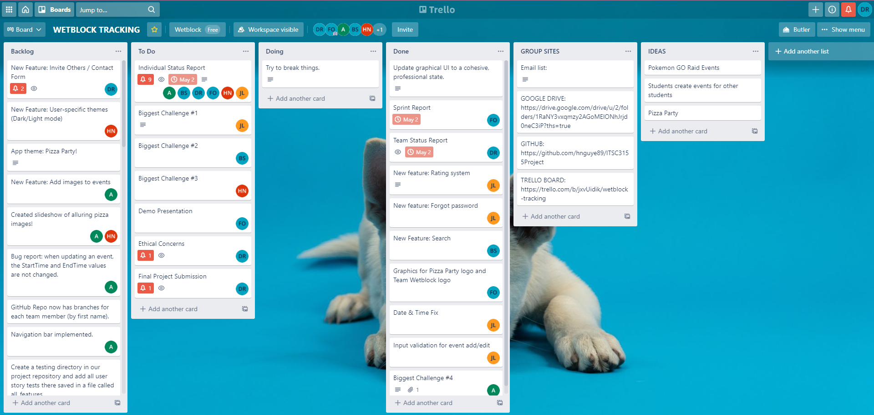
Trello Board

Slide 43

Thanks for Tuning In!

